Slide 1
Citibike Analysis
Using Tableau

Slide 2
Work Flow
Download citibike data for 2018
Concatenate the data using python pandas
Analyze citibike data using tableau

Slide 3
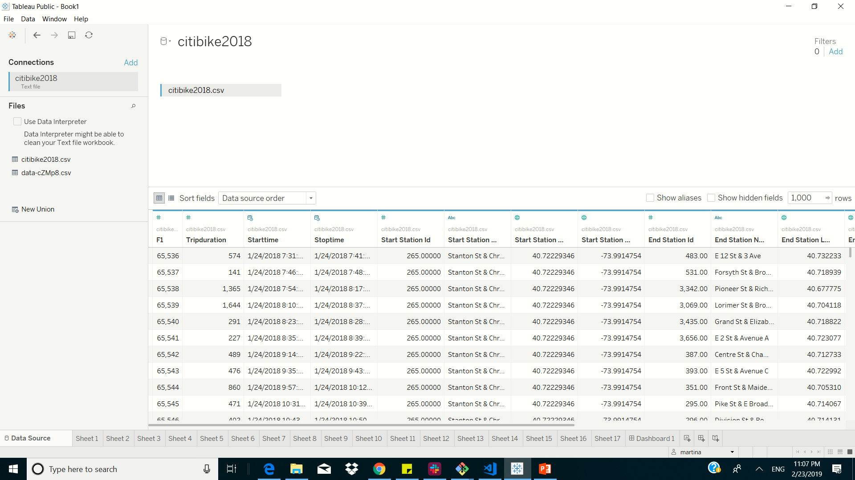
Tableau data

Slide 4
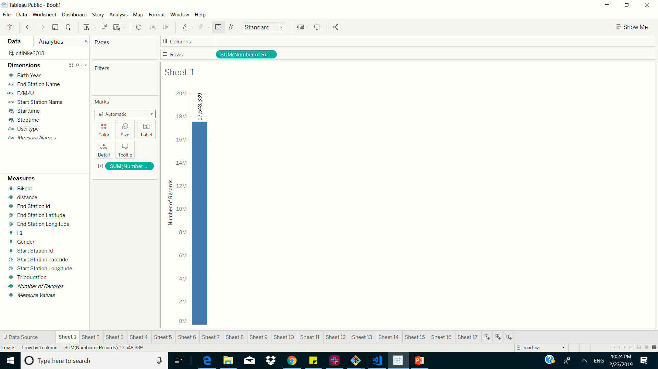
Number of trips recorded total during the chosen period 2018

Slide 5
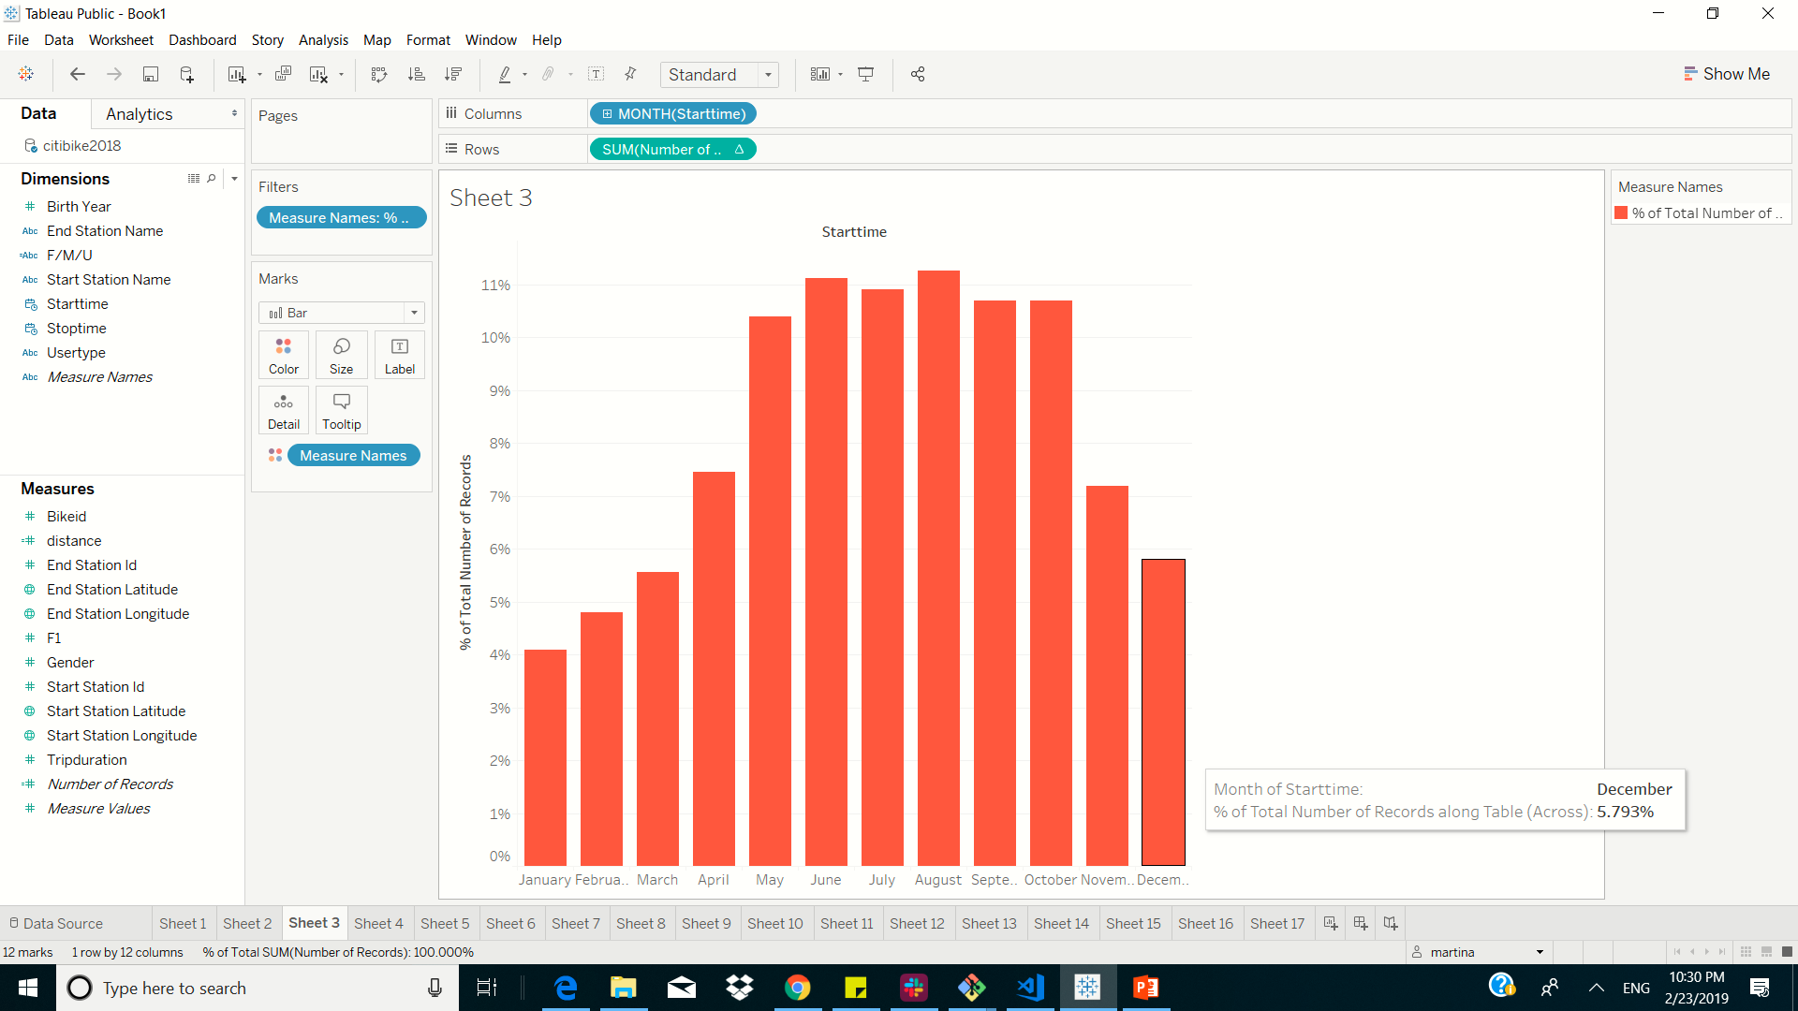
total ridership grows in the months from may to October

Slide 6
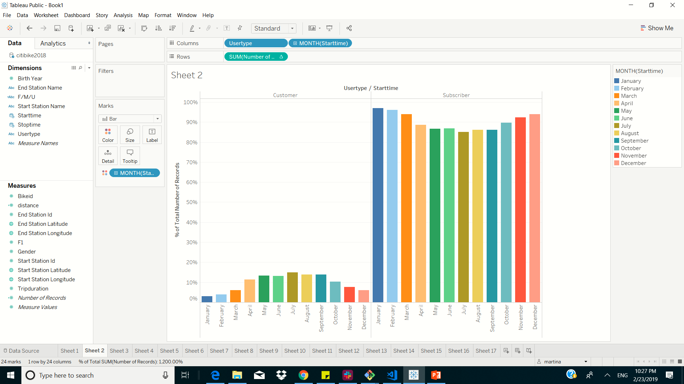
short-term customers VS. annual subscribers changes

Slide 7
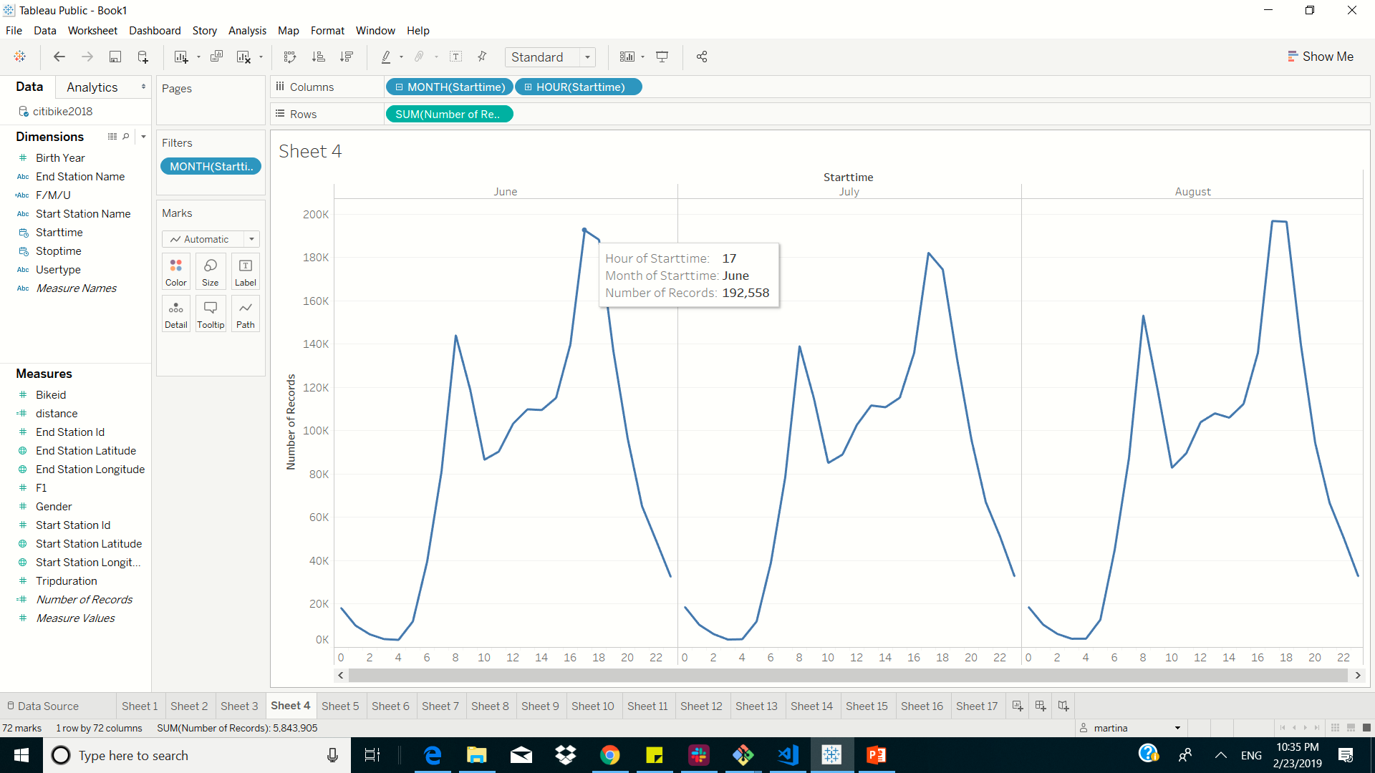
peak hours in which bikes are used during summer months

Slide 8
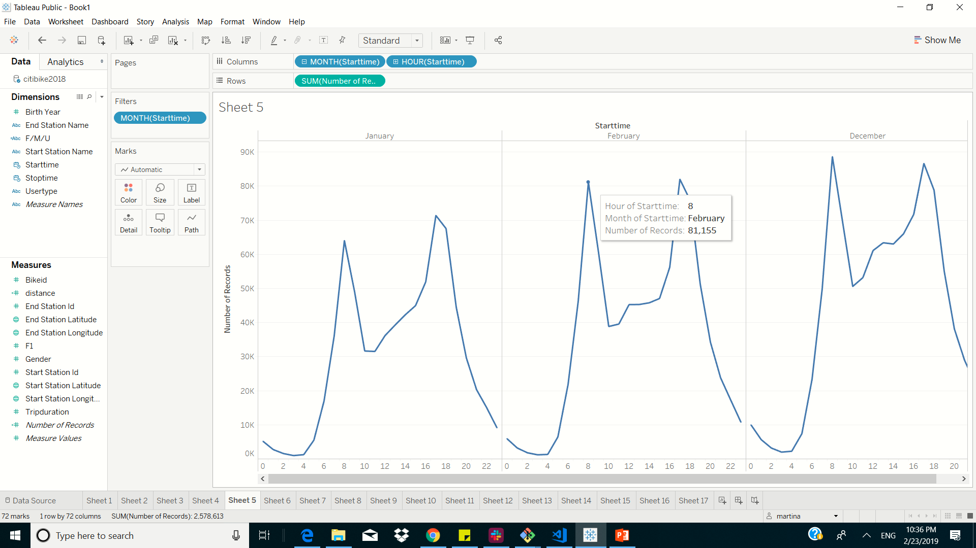
peak hours in which bikes are used during winter months

Slide 9
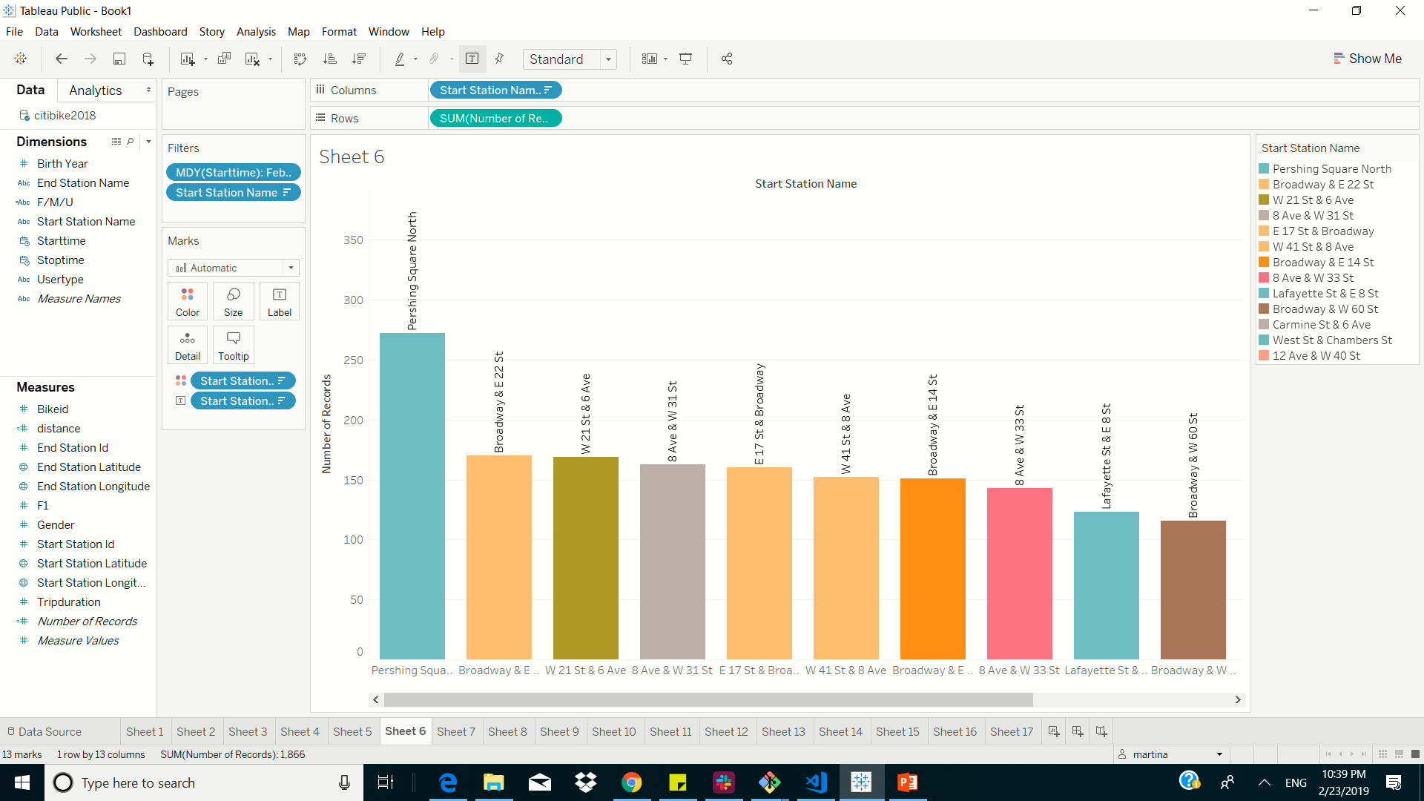
top 10 stations in the city for starting a journey filtered by date 2/23/2018 and based on number of trips on that day

Slide 10
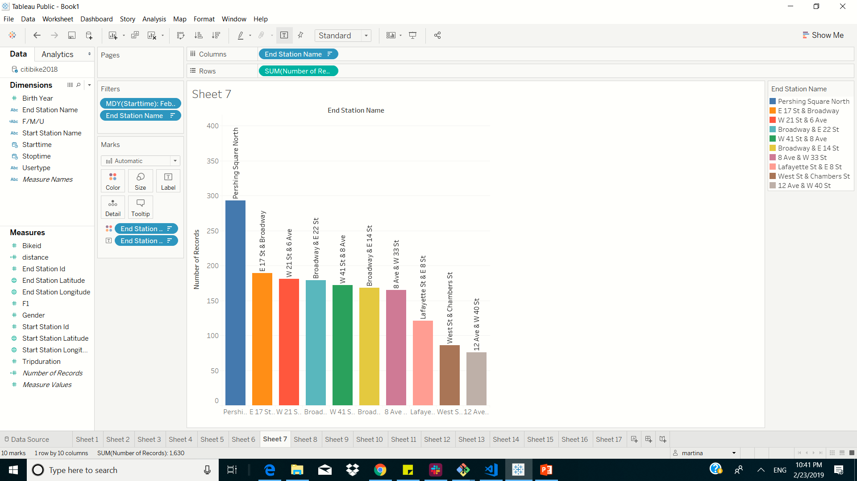
top 10 stations in the city for ending a journey filtered by date 2/23/2018 and based on number of trips on that day

Slide 11
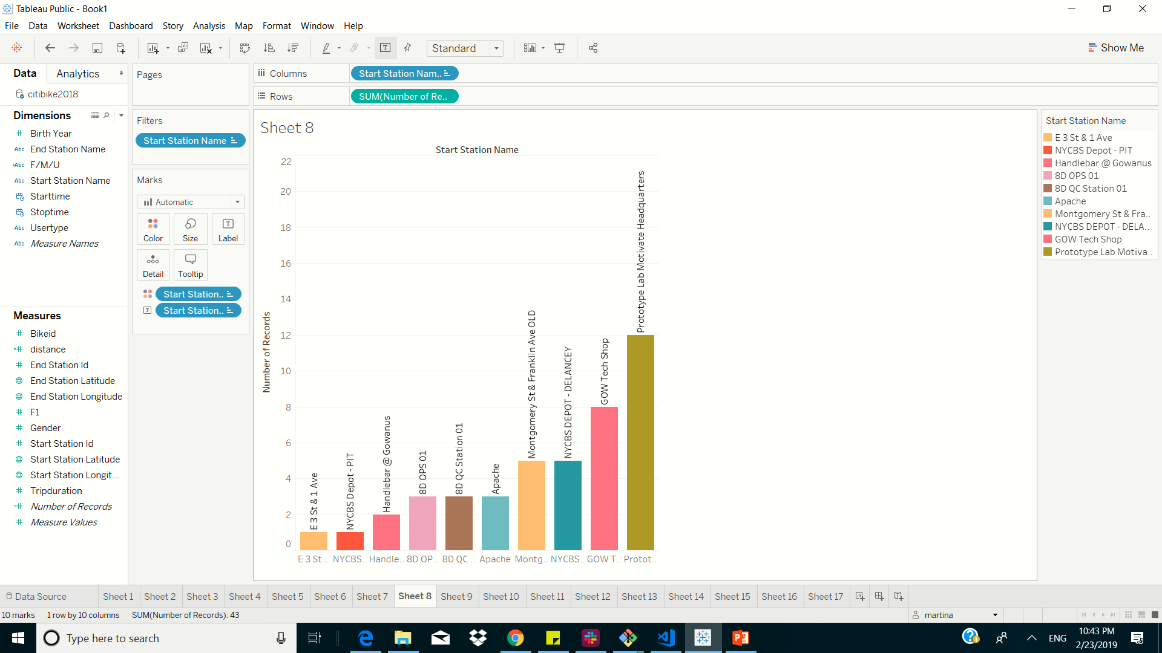
bottom 10 stations in the city for starting a journey filtered by date 2/23/2018 and based on number of trips on that day

Slide 12
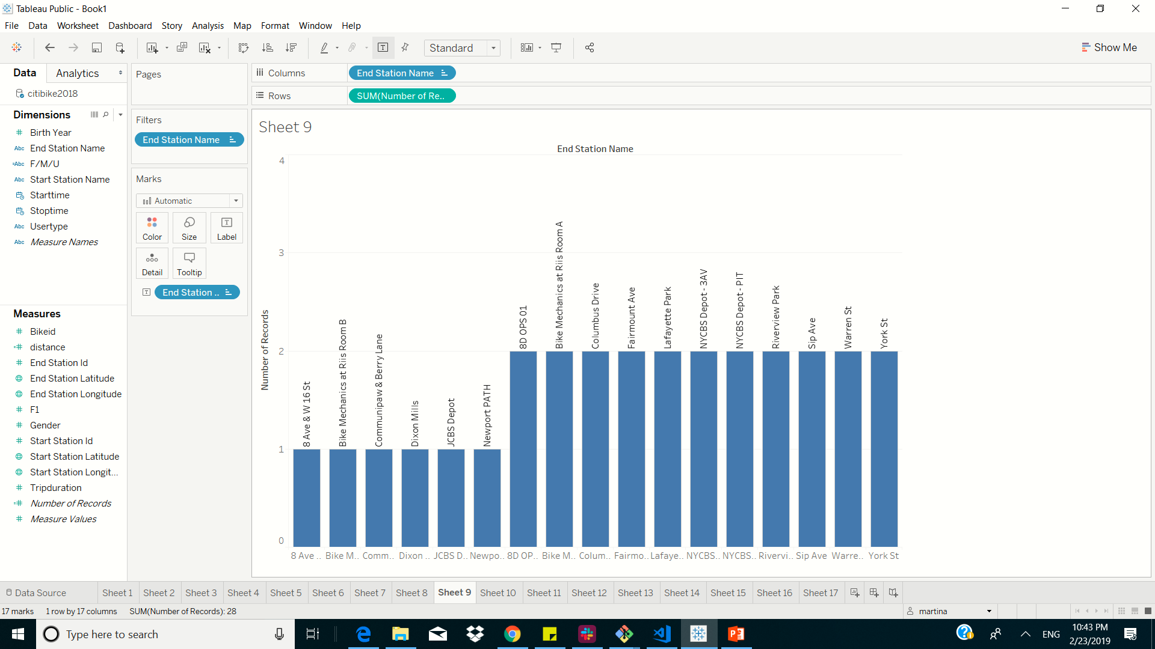
bottom 10 stations in the city for ending a journey filtered by date 2/23/2018 and based on number of trips on that day

Slide 13
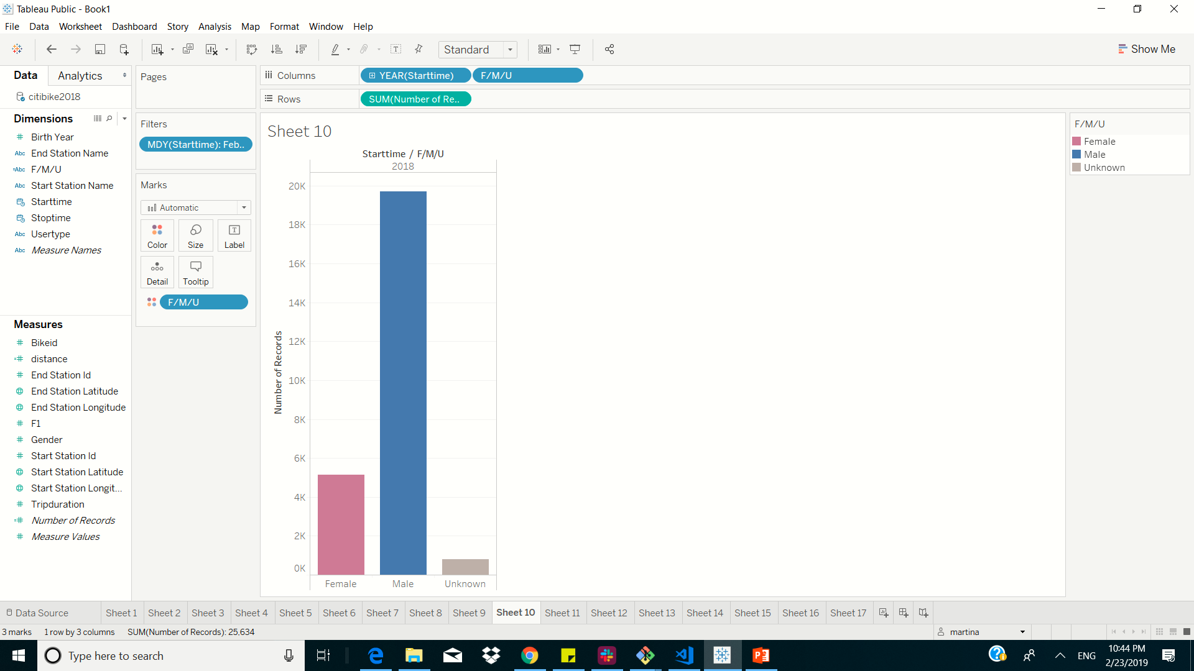
gender breakdown of active participants (Male v. Female)

Slide 14
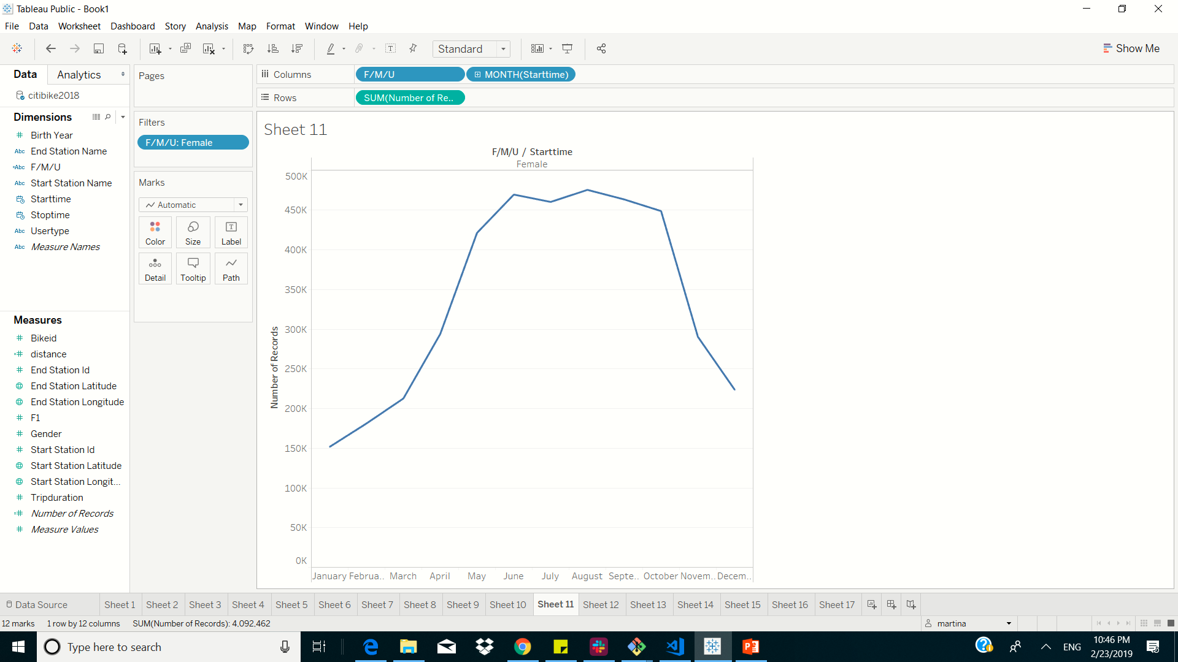
female ridership over the timespan 2018

Slide 15
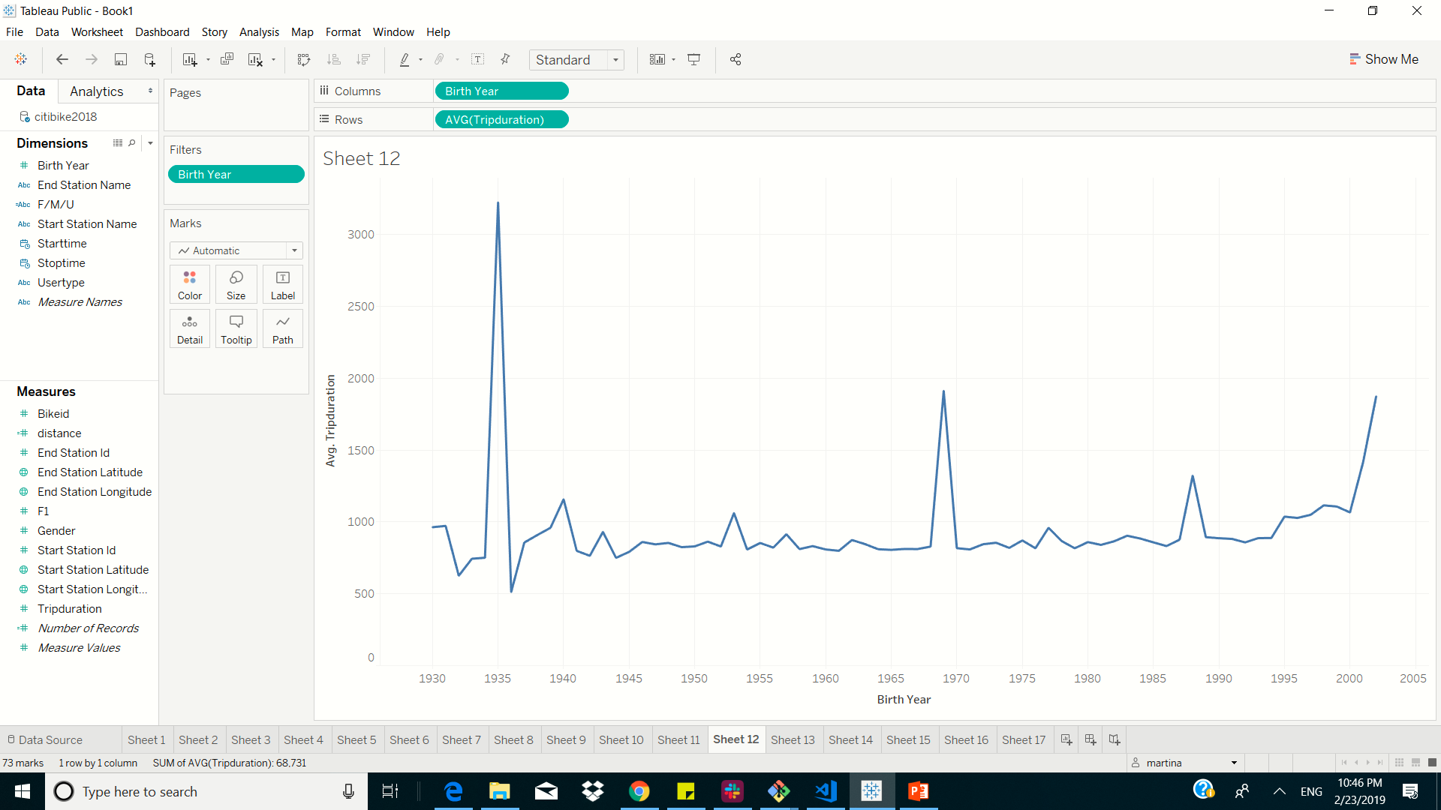
average trip duration change by age starting from year1930 (this data is off)

Slide 16
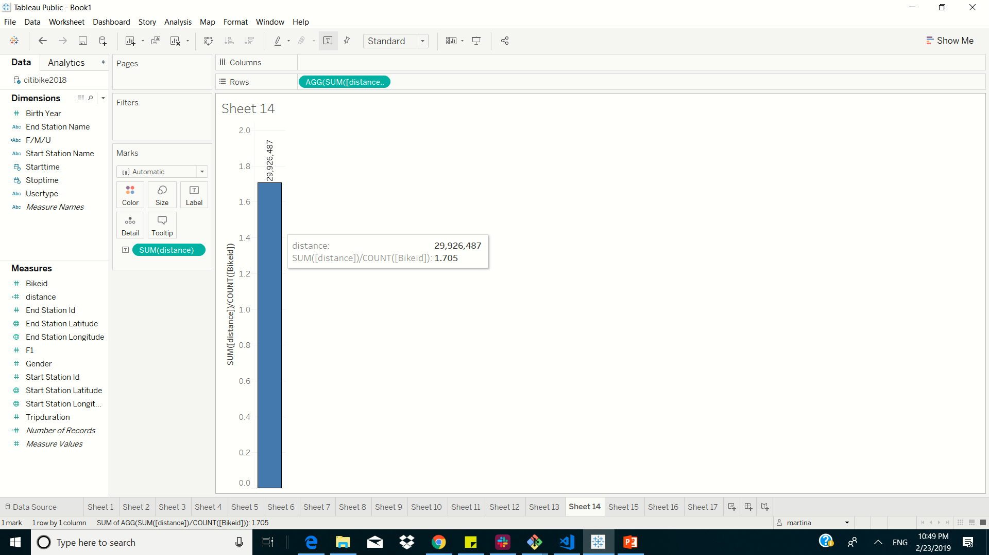
average distance in miles that a bike is ridden

Slide 17
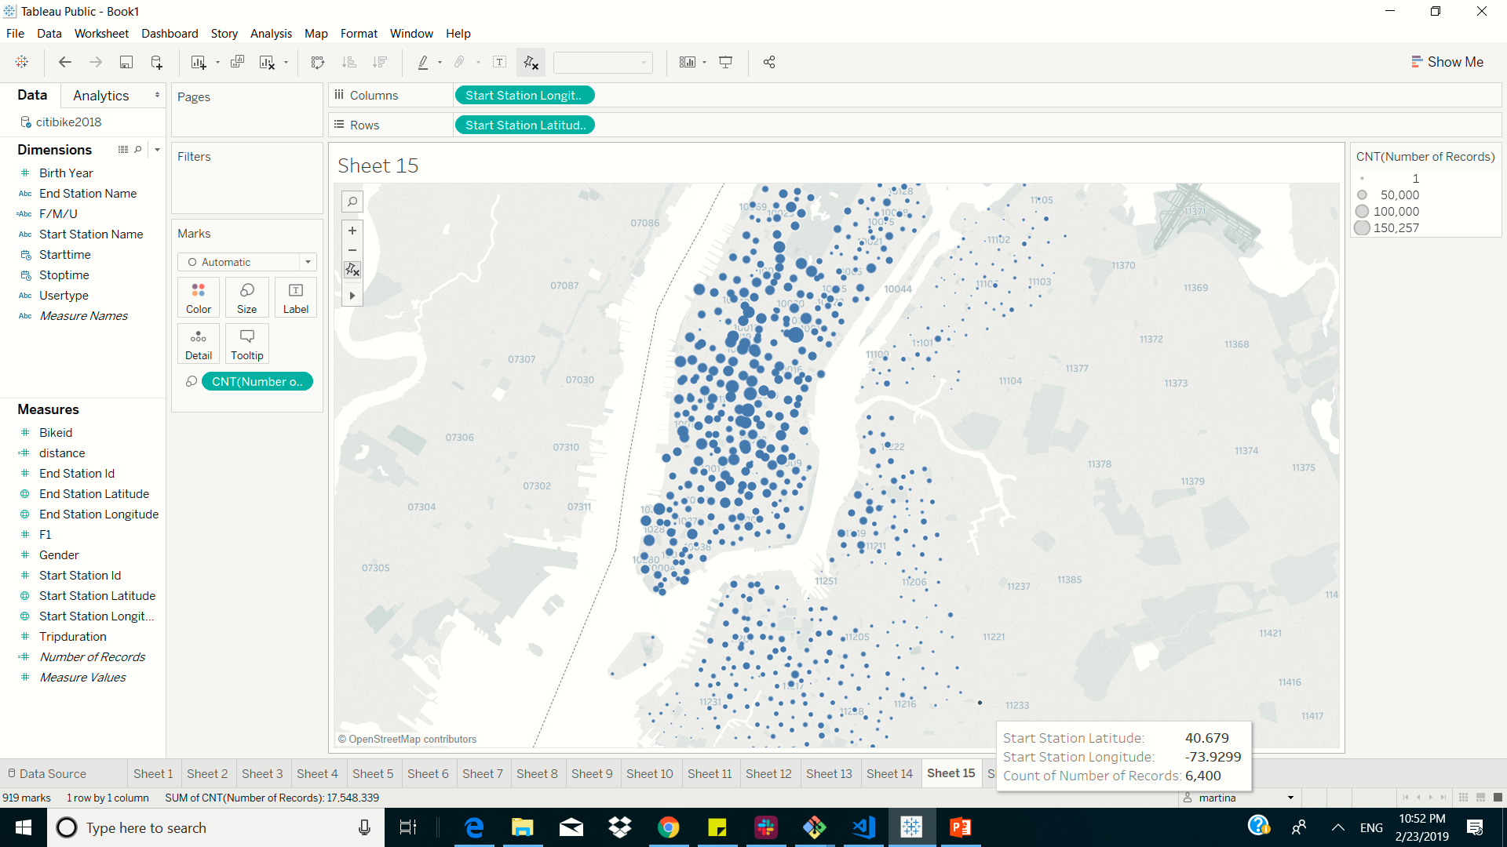
static map that plots all bike stations with a visual indication of the most popular locations to start and end a journey with zip code data overlaid on top.

Slide 18
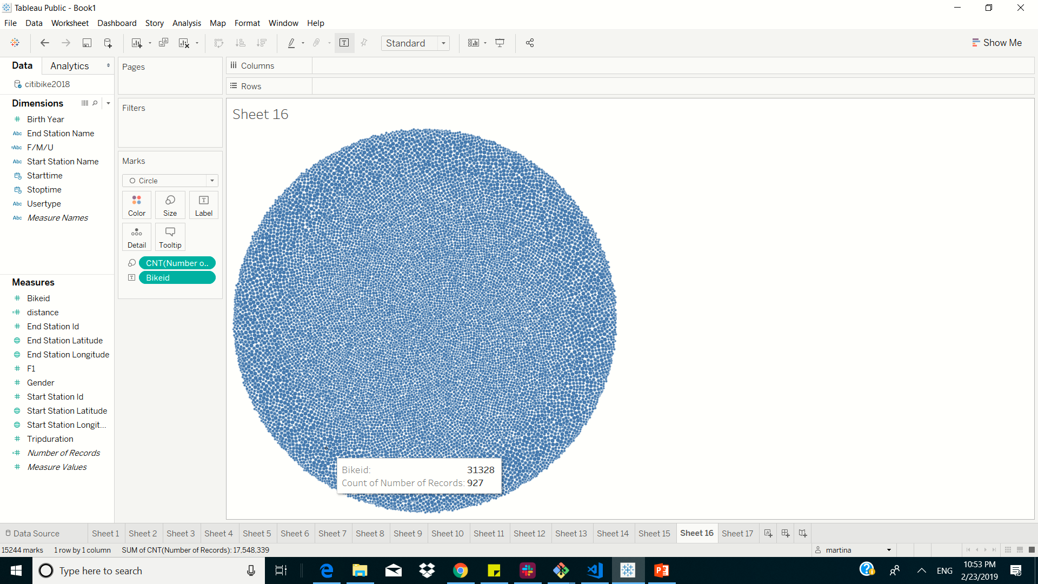
All bikes are ridden almost the same

Slide 19
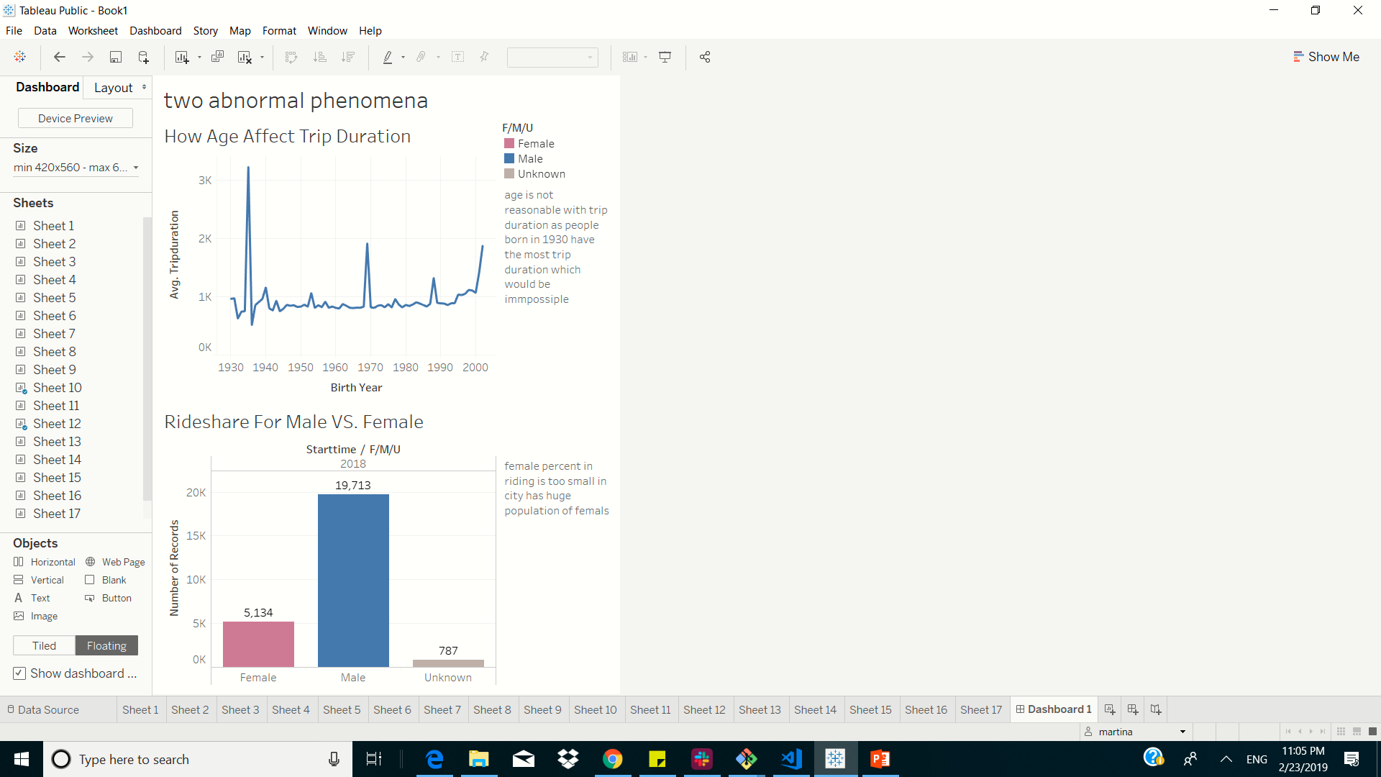
Two abnormal phenomena

